Slide 1
Managed Extensibility Framework
Why, Where and How to Use?

Slide 2
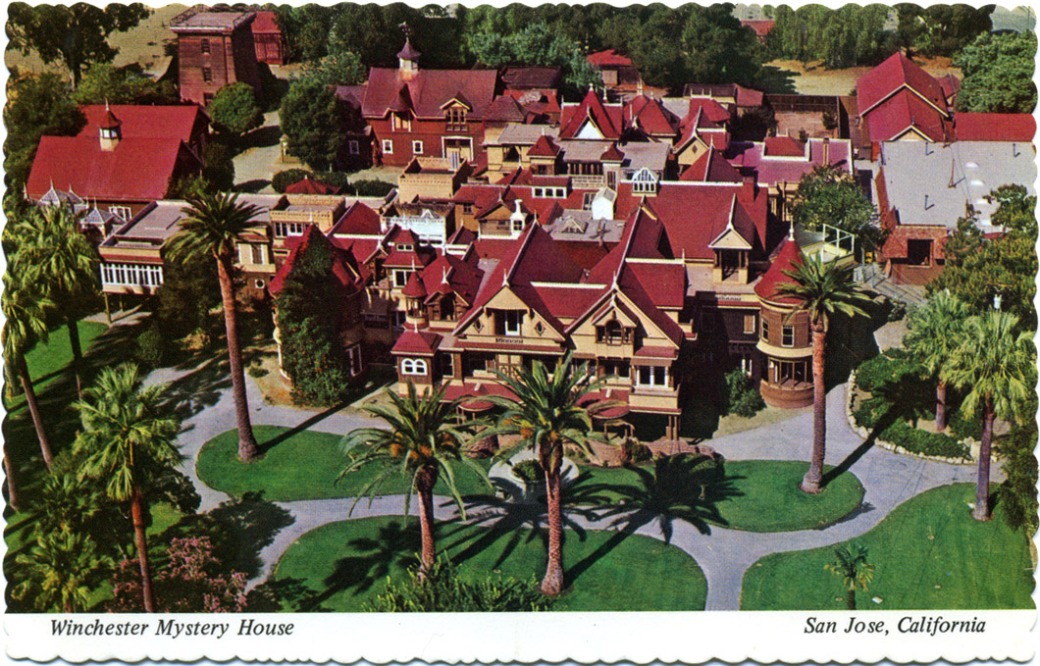
Notes:
http://en.wikipedia.org/wiki/Winchester_Mystery_House
There is no master plan for extensions.

Slide 3
Session Objectives and Key Takeaways
Session Objectives
What is extensibility?
Understand why and where MEF would be used
Understand how MEF is used
Key Takeaways
Understand importance of extensibility to software
Understand when and how MEF is used
Relation to other existing technologies

Slide 4
What is extensibility?
Where does MEF fit?
MEF Basics
Import, Export, Container, Catalogs
MEF Lifetime and Scoping

Slide 5
The Problem…
Software
Maintenance
Original Software
Development
Notes:
One of the biggest problems today is the amount of time spent doing software maintenance instead of original software development.
A recent study showed that 80% of time is spent on maintenance.
MEF presents a simple solution for the runtime extensibility problem. Until now, any application that wanted to support a plugin model needed to create its own infrastructure from scratch. Those plugins would often be application-specific and could not be reused across multiple implementations.

Slide 6
Managed Extensibility Framework What is it?
The Managed Extensibility Framework (MEF) is a new library in the .NET Framework that enables greater reuse of applications and components. Using MEF, .NET applications can make the shift from being statically compiled to dynamically composed.
Notes:
Managed Extensibility Framework (MEF) is a component of .NET Framework 4.0 for creating lightweight, extensible applications. It allows application developers to discover and use extensions with no configuration required. It also lets extension developers easily encapsulate code and avoid fragile hard dependencies. MEF not only allows extensions to be reused within applications, but across applications as well. MEF was introduced as a part of .NET 4.0 and Silverlight 4. It is available on CodePlex along with source and as a result can be used, albeit unsupported and with limitations, on earlier releases of .NET.

Slide 7

com·pose [ kəmpṓz ]
To put things together to form a whole
MSN Encarta
Notes:
Focus on building blocks that snap together to build the application.

Slide 8
Open/Closed Principle
Software entities should be
open for extension,
but closed for modification.
Notes:
Normal OO design. Extension != modification.
You should be able to extend your class but not allow consumers to actually modify the existing source code. Modification creates risk and instability and versioning problems.
What if your application was written so that you could write a class and the application would automatically consume and use it without modifying the app’s source code? Independence of development and testing (both architecturally as well as organizationally)

Slide 9
Known
vs.
Unknown
Notes:
Do you know everything app ship time? Traditionally yes – you know all the classes and references and requirements. But what if you could write it so that you didn’t need to know. Allowing 3rd party extensibility (e.g. Visual Studio, Office)

Slide 10

MEF Basics…
An Application is built of parts.
Notes:
Parts are the lego blocks. You make these available for the application to consume.
Roughly speaking, MEF's core consists of a catalog and a CompositionContainer. A catalog is responsible for discovering extensions and the container coordinates creation and satisfies dependencies.

Slide 11
MEF Basics…
Export it.
Import it.
Compose it.
Notes:
This is all you need to know for MEF.
EXPORT – publish/declare a part available
IMPORT – consume/require a part to be available to my app. The app doesn’t know who will fulfill the requirement. It just declares the requirement.
COMPOSE – Containers provide all the parts available that meet declared requirements and the app puts them together and consumes them. They might come from the file system, the network or the web, etc.

Slide 12
Part, enter stage left…
public class SimpleMortgageCalculator : IMortgageCalculator
{
public ILogger Logger { get; set; }
public float Calculate()
{
Logger.Log("Calculating Mortgage");
return ...;
}
}
Part
A

Slide 13
Export
[Export(typeof(IMortgageCalculator))]
public class SimpleMortgageCalculator : IMortgageCalculator
{
public ILogger Logger { get; set; }
public float Calculate()
{
Logger.Log("Calculating Mortgage");
return ...;
}
}
Part
A

Slide 14
Importit…
[Export(typeof(IMortgageCalculator))]
public class SimpleMortgageCalculator : IMortgageCalculator
{
[Import(typeof(ILogger))]
public ILogger Logger { get; set; }
public float Calculate()
{
Logger.Log("Calculating Mortgage");
return ...;
}
}
Part
A

Slide 15
Compose it.
Catalogs provide the parts.
Catalog
Notes:
2 moving parts for composition
Catalogs = provides the parts from some source
On next slide

Slide 16
Compose it.
Container is the matchmaker.
Catalog
Notes:
2 moving parts for composition
Catalogs = provides the parts from some source
Containers – gets all the parts from the containers and matches all the Exports & Imports

Slide 17


Catalog Categories.
Aggregating Catalog
Directory Catalog
Assembly Catalog
Type Catalog
Notes:
Out of the box we provide a few catalogs
TypeCatalog – explicitly register a type
AssemblyCatalog – find parts in the assembly
DirectoryCatalog – find parts in assemblies in a directory
AggregatingCatalog – combine the other catalog types together into a single catalog
Can also make custom catalogs

Slide 18
1. MEF Basics
Notes:
Add simple composition to the app.
MEF provides a standard way for the host application to expose itself and consume external extensions. Extensions, by their nature, can be reused amongst different applications. However, an extension could still be implemented in a way that is application-specific. Extensions themselves can depend on one another and MEF will make sure they are wired together in the correct order (another thing you won't have to worry about).
MEF offers a set of discovery approaches for your application to locate and load available extensions.
MEF allows tagging extensions with additional metadata which facilitates rich querying and filtering

Slide 19
Metadata…
[Export(typeof(IMortgageCalculator))]
[ExportMetadata(“Calculation”, “Simple”)]
[ExportMetadata(“Tax Aware”, null)]
public class SimpleMortgageCalculator : IMortgageCalculator
{
public ILogger Logger { get; set; }
public float Calculate()
{
Logger.Log("Calculating Mortgage");
return ...;
}
}
Part
A
Notes:
Others things you might want to do – associate metadata with a part

Slide 20
Parts can be lazy…
[Import(typeof(ILogger))]
public ILogger Logger { get; set; }
Part
A
Part
B
Notes:
Lazy loading is delay loading until the type is actually referenced. This can greatly speed up startup time and reduce application footprint

Slide 21
Parts can be lazy…
[Import(typeof(ILogger))]
public ILoggerLazy<ILogger>Logger { get; set; }
Part
A
Lazy
<B>
Notes:
Lazy loading is delay loading until the type is actually referenced. This can greatly speed up startup time and reduce application footprint

Slide 22
2. Metadata and Lazy Evaluation
Notes:
Change the composition to happen lazily
Add some metadata to the sample app so that it detects whether the network interface is online/offline then databinds the appropriate source by looking at the offline metadata of the parts.

Slide 23
The slippery slope…
[Export(typeof(IMortgageCalculator))]
[ExportMetadata(“Calculation”, “Simple”)]
[ExportMetadata(“Tax Aware”, null)]
[ExportMetadata(“This”, “foo”)]
[ExportMetadata(“That”, “bar”)]
Part
A
Notes:
Lots of metadata can quickly get out of hand. Its also not strongly typed.

Slide 24
The slippery slope… solved
[Export(typeof(IMortgageCalculator))]
[ExportMetadata(“Calculation”, “Simple”)]
[ExportMetadata(“Tax Aware”, null)]
[ExportMetadata(“This”, “foo”)]
[ExportMetadata(“That”, “bar”)]
Part
A
[Export(typeof(IMortgageCalculator))]
[CalcCapabilities(
Mode=Complexity.Simple,
TaxAware=true,
This=“foo”,
That=“bar”)]
Notes:
We can have strongly typed metadata in MEF. Reduces complexity of declaration as well as provides strongly typed compile time enforcement of consumption of the metadata.

Slide 25
3. Strongly-Typed Metadata
Notes:
Change the metadata in the sample to be a custom type called NetworkAwarenessAttribute which handles the online/offline metadata of the imported types

Slide 26
The importance of context!
Notes:
But the listing window in the demo is required to be network aware. Why should the window have that capability. What if we took that code and removed it so that it looked like the original sample and MEF handles the network awareness for us. We want MEF to handle the context of which listing item needs to be used.

Slide 27
4. Context Awareness

Slide 28
Lifetime
Non-Shared
Shared
Container
Container
Part A
Part B
Part B
Part B
Notes:
MEF has the ability to export something as a single or multiple instance. Default is same instance.

Slide 29
5. Lifetime

Slide 30
But……
Where are the
so-called external dependencies?
Notes:
All previous examples are known composition. What about unknown? So wiring up external dependencies is a natural extension of the previously shown process

Slide 31
Dependencies
.\Extensions
Composition Container
Notes:
Lets add a directory where the application will pick up external dependencies. VS 2010 editor uses MEF to compose all the plugins it knows about.

Slide 32
6. External Dependencies

Slide 33
The Power of Being Declarative
What vs. How?
Notes:
We’ve been using attributes for import/export. Every layer of MEF is built for tweaking. There is a primitive layer with which you can build your own model on top – e.g. build an xml wiring model. We went attributes because it is declarative. Focusing on the what instead of the how. “This is an extension point!” Since it is declarative you could even analyze the apps programatically to determine what extensibility points it provides.

Slide 34
We Started with the Problem…
Software
Maintenance
Original Software
Development
Notes:
One of the biggest problems today is the amount of time spent doing software maintenance instead of original software development.
A recent study showed that 80% of time is spent on maintenance.

Slide 35
The Solution…
Software
Maintenance
Original
Software
Development

Slide 37
Using Managed Extensibility Framework

Slide 38
Resources
http://mef.codeplex.com
MEF on MSDN http://msdn.microsoft.com/en-us/library/dd460648(VS.100).aspx
Clean Code, Robert C. Martin
Working Effectively with Legacy Code,
Michael Feathers
Refactoring, Martin Fowler

Slide 40
Appendix
Notes:
All previous examples are known composition. What about unknown? So wiring up external dependencies is a natural extension of the previously shown process

Slide 41
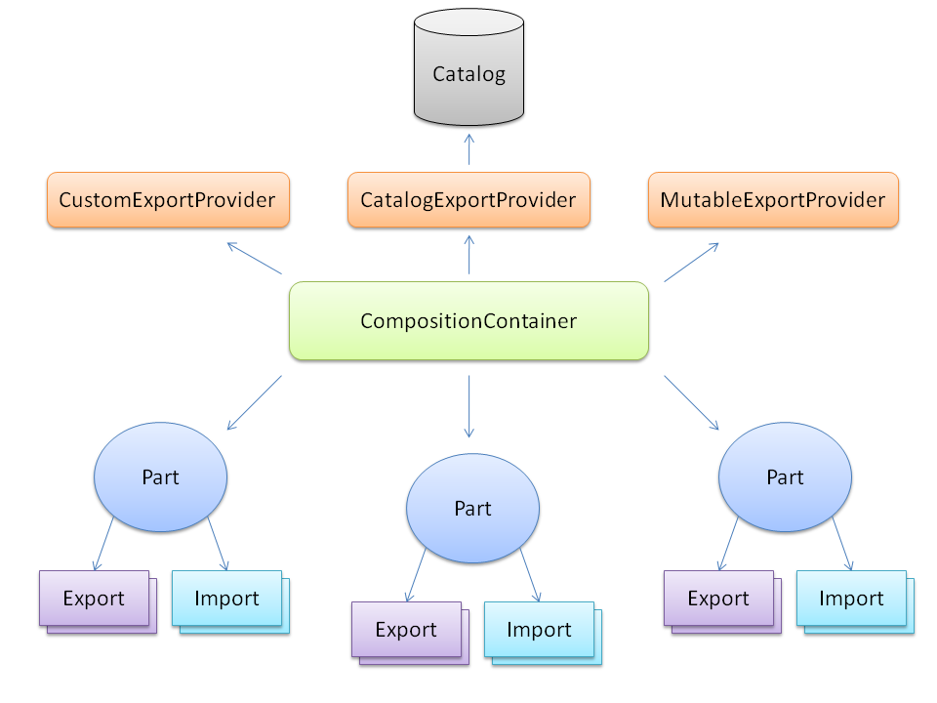
MEF Architecture

Slide 42
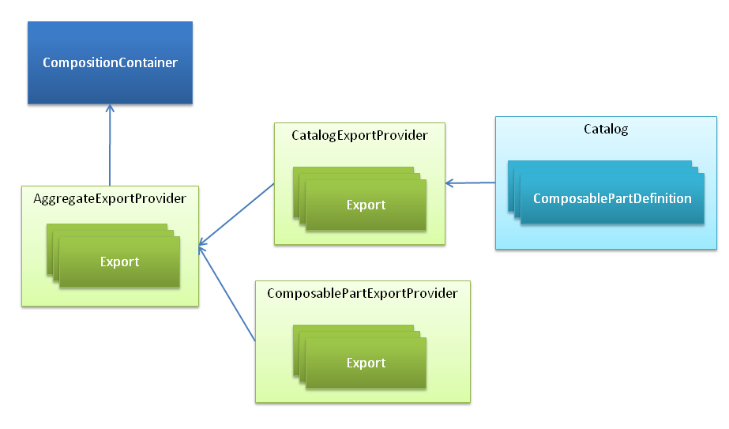
MEF Architecture

Slide 43
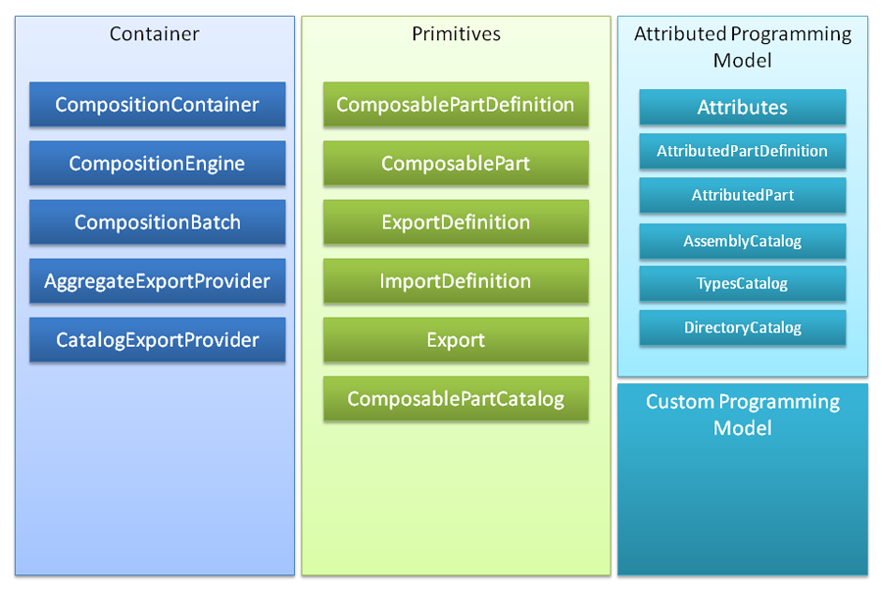
MEF Container

